Slide 1
Dr. Yifeng Zhu Electrical and Computer Engineering University of Maine
Embedded Systems with ARM Cortex-M Microcontrollers in Assembly Language and C
Chapter 18
Real-time Clock (RTC)
Spring 2020

Slide 2
Real-Time Clock (RTC)
RTC is a digital clock that provides calendar time and date.
Typical requirements:
Low power consumption
Separately powered by a battery
Accurate
Run independently from the processor core

Slide 3

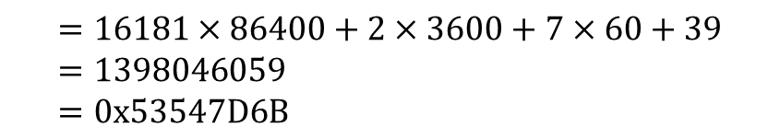
UNIX Epoch Time
Definition: number of seconds that have elapsed since 00:00:00 UTC, Thursday, 1 January 1970
Example:
Converting 2:07:39am, April 21, 2014 (UTC) to Unix Epoch number
$$UNIX Epoch Number$$
$$=16181 days×\frac{seconds}{day}+2 hours×\frac{seconds}{hour}+7 minutes×\frac{seconds}{minutes}+39$$
$$=16181×86400+2×3600+7×60+39 \\ =1398046059 \\ =0x53547D6B$$
Note a day has 86400 seconds ($24×60×60=86400$)

Slide 4
UNIX Epoch Time
Use a signed 32-bit integer to hold the UNIX Epoch Time
Covers a time span of 136 years.
Minimum representable time is 1901-12-13
Maximum representable time is 2038-01-19
Year 2038 Problem (also called Unix Millennium Bug)
The second after 03:14:07 UTC 2038-01-19 is an overflow (which became 1901-12-13).
Use a signed 64-bit integer to fix the problem
A challenge in embedded systems

Slide 5
Crystal Inaccuracy: PPM
Parts Per Million (PPM) = 10⁻⁶
Crystal Inaccuracy
1 PPM ⟶ ±1.1 seconds per year
A typical watch crystal has 20 PPM
Error per day: 86400 seconds × 20 × 10⁻⁶ = 1.728 seconds/day
Error per month: 30 days × 1.728 seconds/day = 51 seconds/month
STM32 RTC
At 25°C, HSI and MSI have an accuracy of 1000 ppm (not accurate enough for RTC)
LSI, 32KHz, 10% accuracy
Need to use external LSE crystal, typically 32.768 kHz (2¹⁵ Hz), 20 ppm
Why 32.768 kHz?
Tradeoff
Low frequency crystals → large physical size
High frequency crystals → large current drain

Slide 6
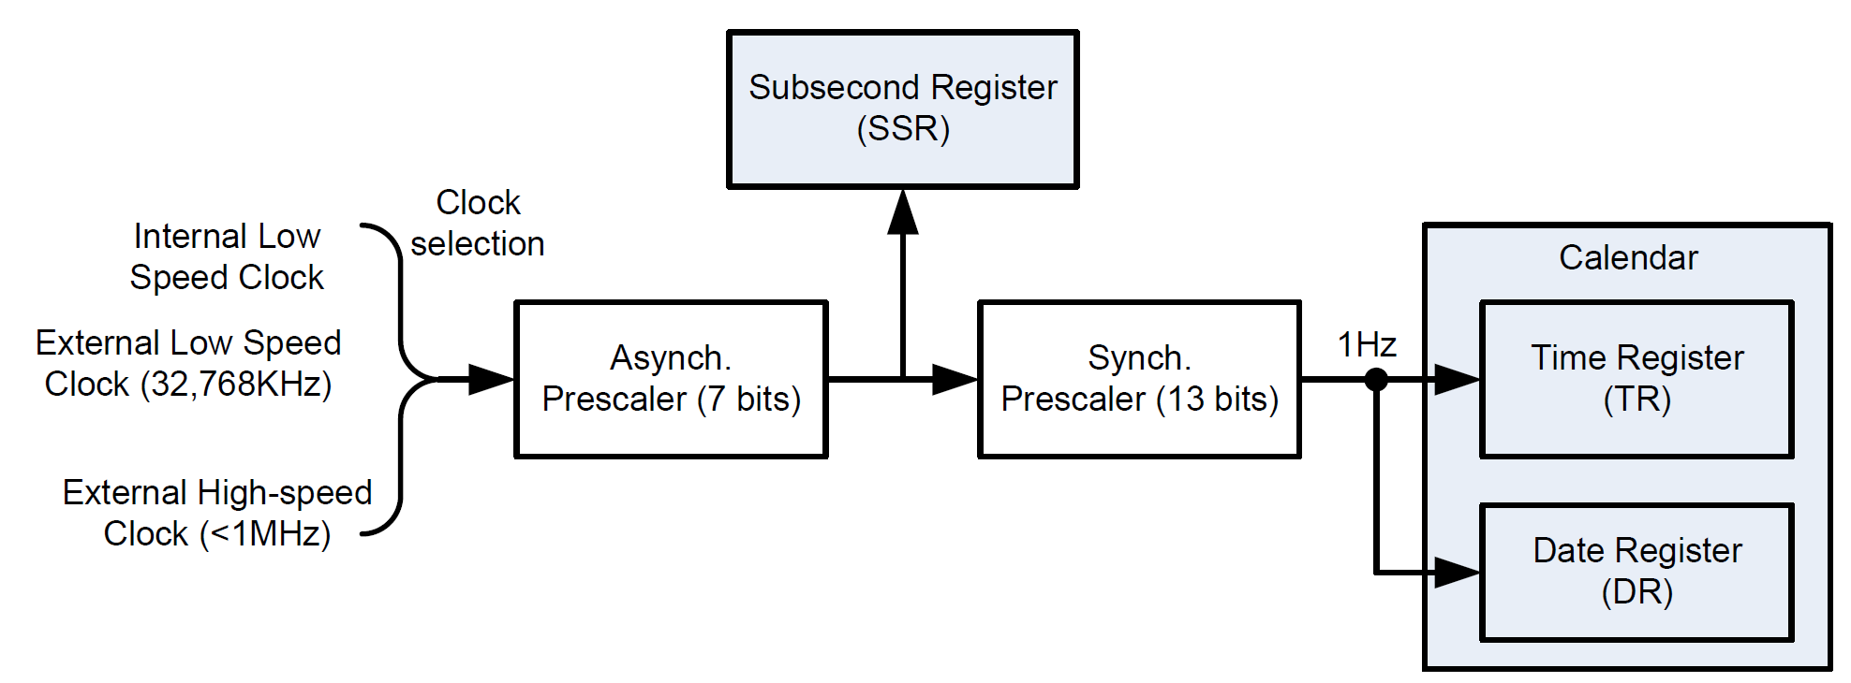
Frequency Setting
$$f_{1Hz}=\frac{f_{RTC}}{\left(Asynch_Prescaler+1\right)×\left(Synch_Prescaler+1\right)}$$

Slide 7
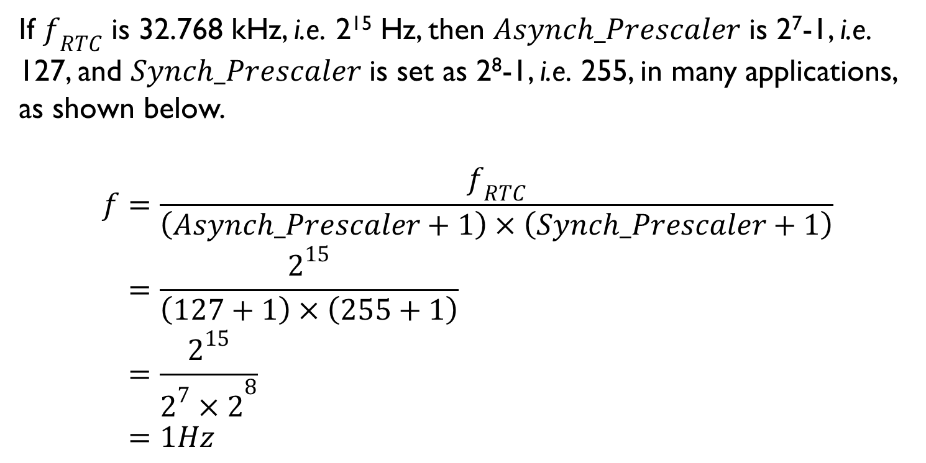
Frequency Setting
If $f_{RTC}$ is 32.768 kHz, i.e. 2¹⁵ Hz, then $Asynch_Prescaler$ is 2⁷-1, i.e. 127, and $Synch_Prescaler$ is set as 2⁸-1, i.e. 255, in many applications, as shown below.
$$f=\frac{f_{RTC}}{\left(Asynch_Prescaler+1\right)×\left(Synch_Prescaler+1\right)} \\ =\frac{2^{15}}{\left(127+1\right)×\left(255+1\right)} \\ =\frac{2^{15}}{{2^{7}×2}^{8}} \\ =1Hz$$

